Slide 1

Motion Sensor Passcode lock
Nathan copros & muntabir choudhury

Slide 2
Introduction
Design a circuit that could be used as a passcode lock
Use motion sensors instead of push buttons
4-digit passcode with numbers from 1 to 4
Can’t have two same consecutive digit; 108 possibilities
This would prevent PIN hacks from thermal signature

Slide 3
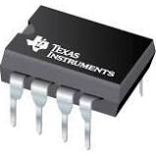
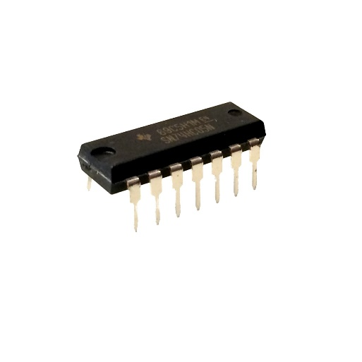
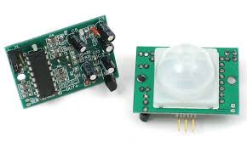
List of Components
555 IC timers
Inverter Logic gates
AND Logic gates
OR Logic gates
LED
10kΩ and 1kΩ Resistors
470µF and 10nF capacitors
PIR Motion sensors
555 IC timer
Logic gates
PIR Motion Sensor

Slide 4
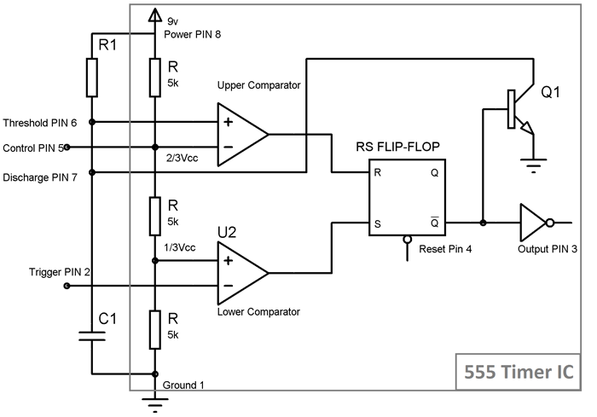
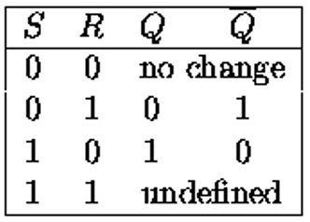
555 IC timer
Monostable mode
Formula:
T = 1.1 * R1 * C1
Truth table RS flip-flop

Slide 5
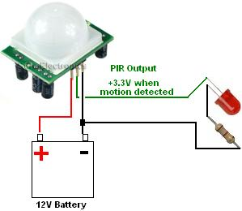
PIR Motion Sensor
Output 0V when no motion
Output around 3.3V when motion detected

Slide 6
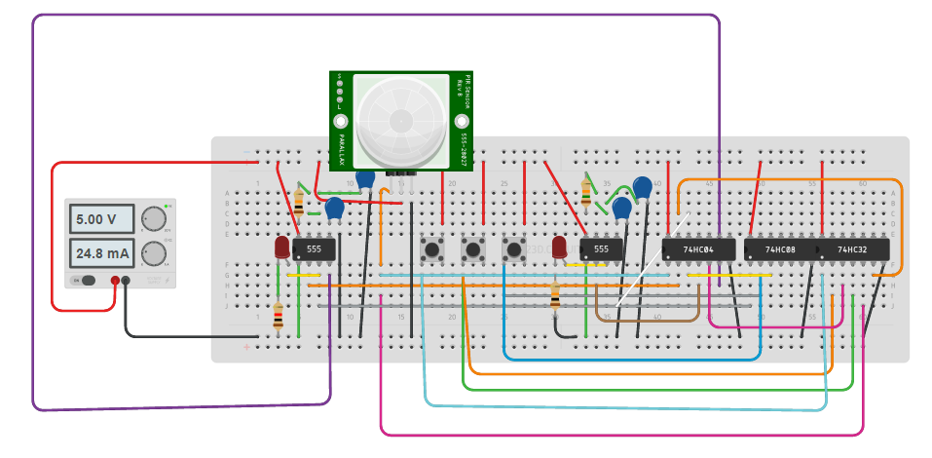
Design and Simulation
Simulation

Slide 7
Building Challenges
The PIR Motion Sensor doesn’t ground when no motion is detected
Solution: OR-ing the PIR with ground so OR gate provides ground or 5V
The PIR outputs for several seconds
Solution: Waiting between each input

Slide 8
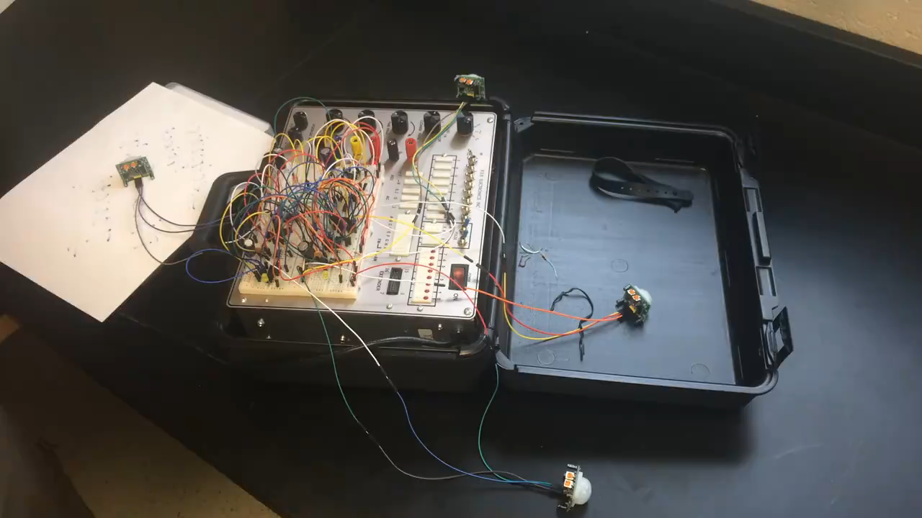
Physical Execution

Slide 9
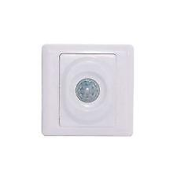
Conclusion
Good way to prevent PIN hacks that use thermal signature
Further Improvement:
Could be optimized with PIR motion sensor switch
Use Raspberry PI to optimize input analysis and detect two consecutive input
Motion Sensor Switch

Slide 10
Thank You Questions?

